Slide 1
Outdoor Education
GUSA Budget Summit February 2020

Slide 2
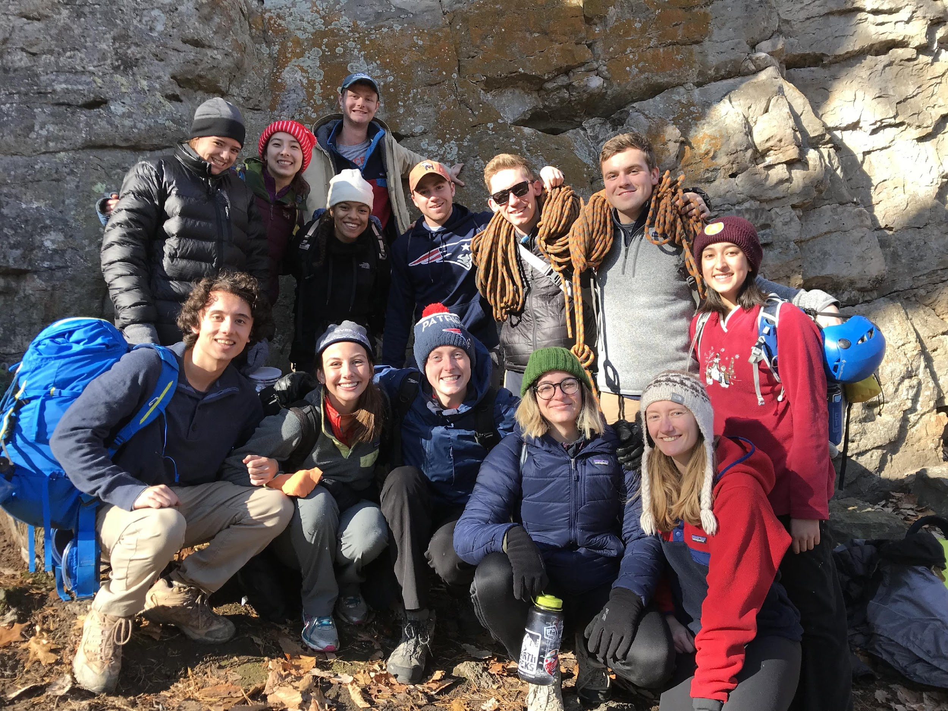
Introduction
Brian Britt ‘17 -- Guide
Reed Hasson ‘17 -- Guide

Slide 3
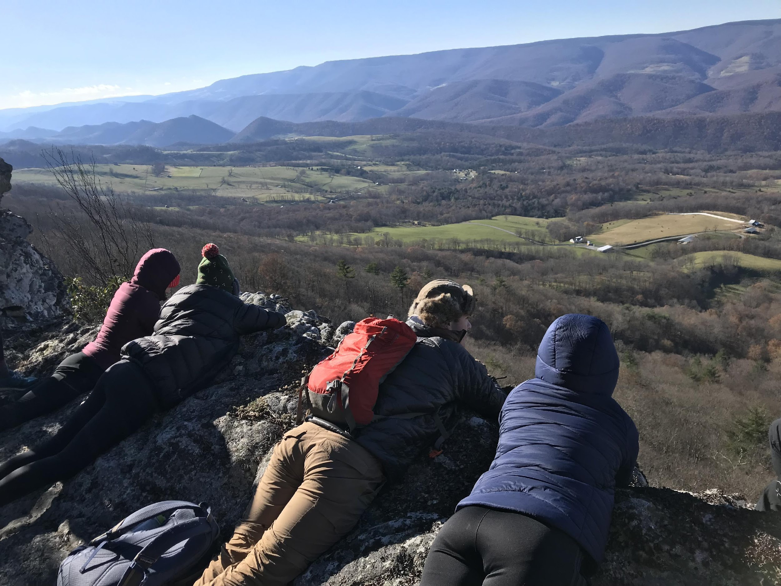
Mission & Organization Structure
Through wilderness based endeavors, Georgetown University Outdoor Education seeks to teach, to inspire, and guide students, creating a community where learning, personal challenge, reflection, and increased compassion for others and the environment are fostered and upheld as core values.
Outdoor Education is a department within the Center for Student Engagement
1 Full-time Director (Kris Nessler)
33 Student Guides (average 50 applications
for 12 spots each year)
Programming
Open Enrollment trips
Guide training/development
9 Pre Orientation Programs

Slide 4
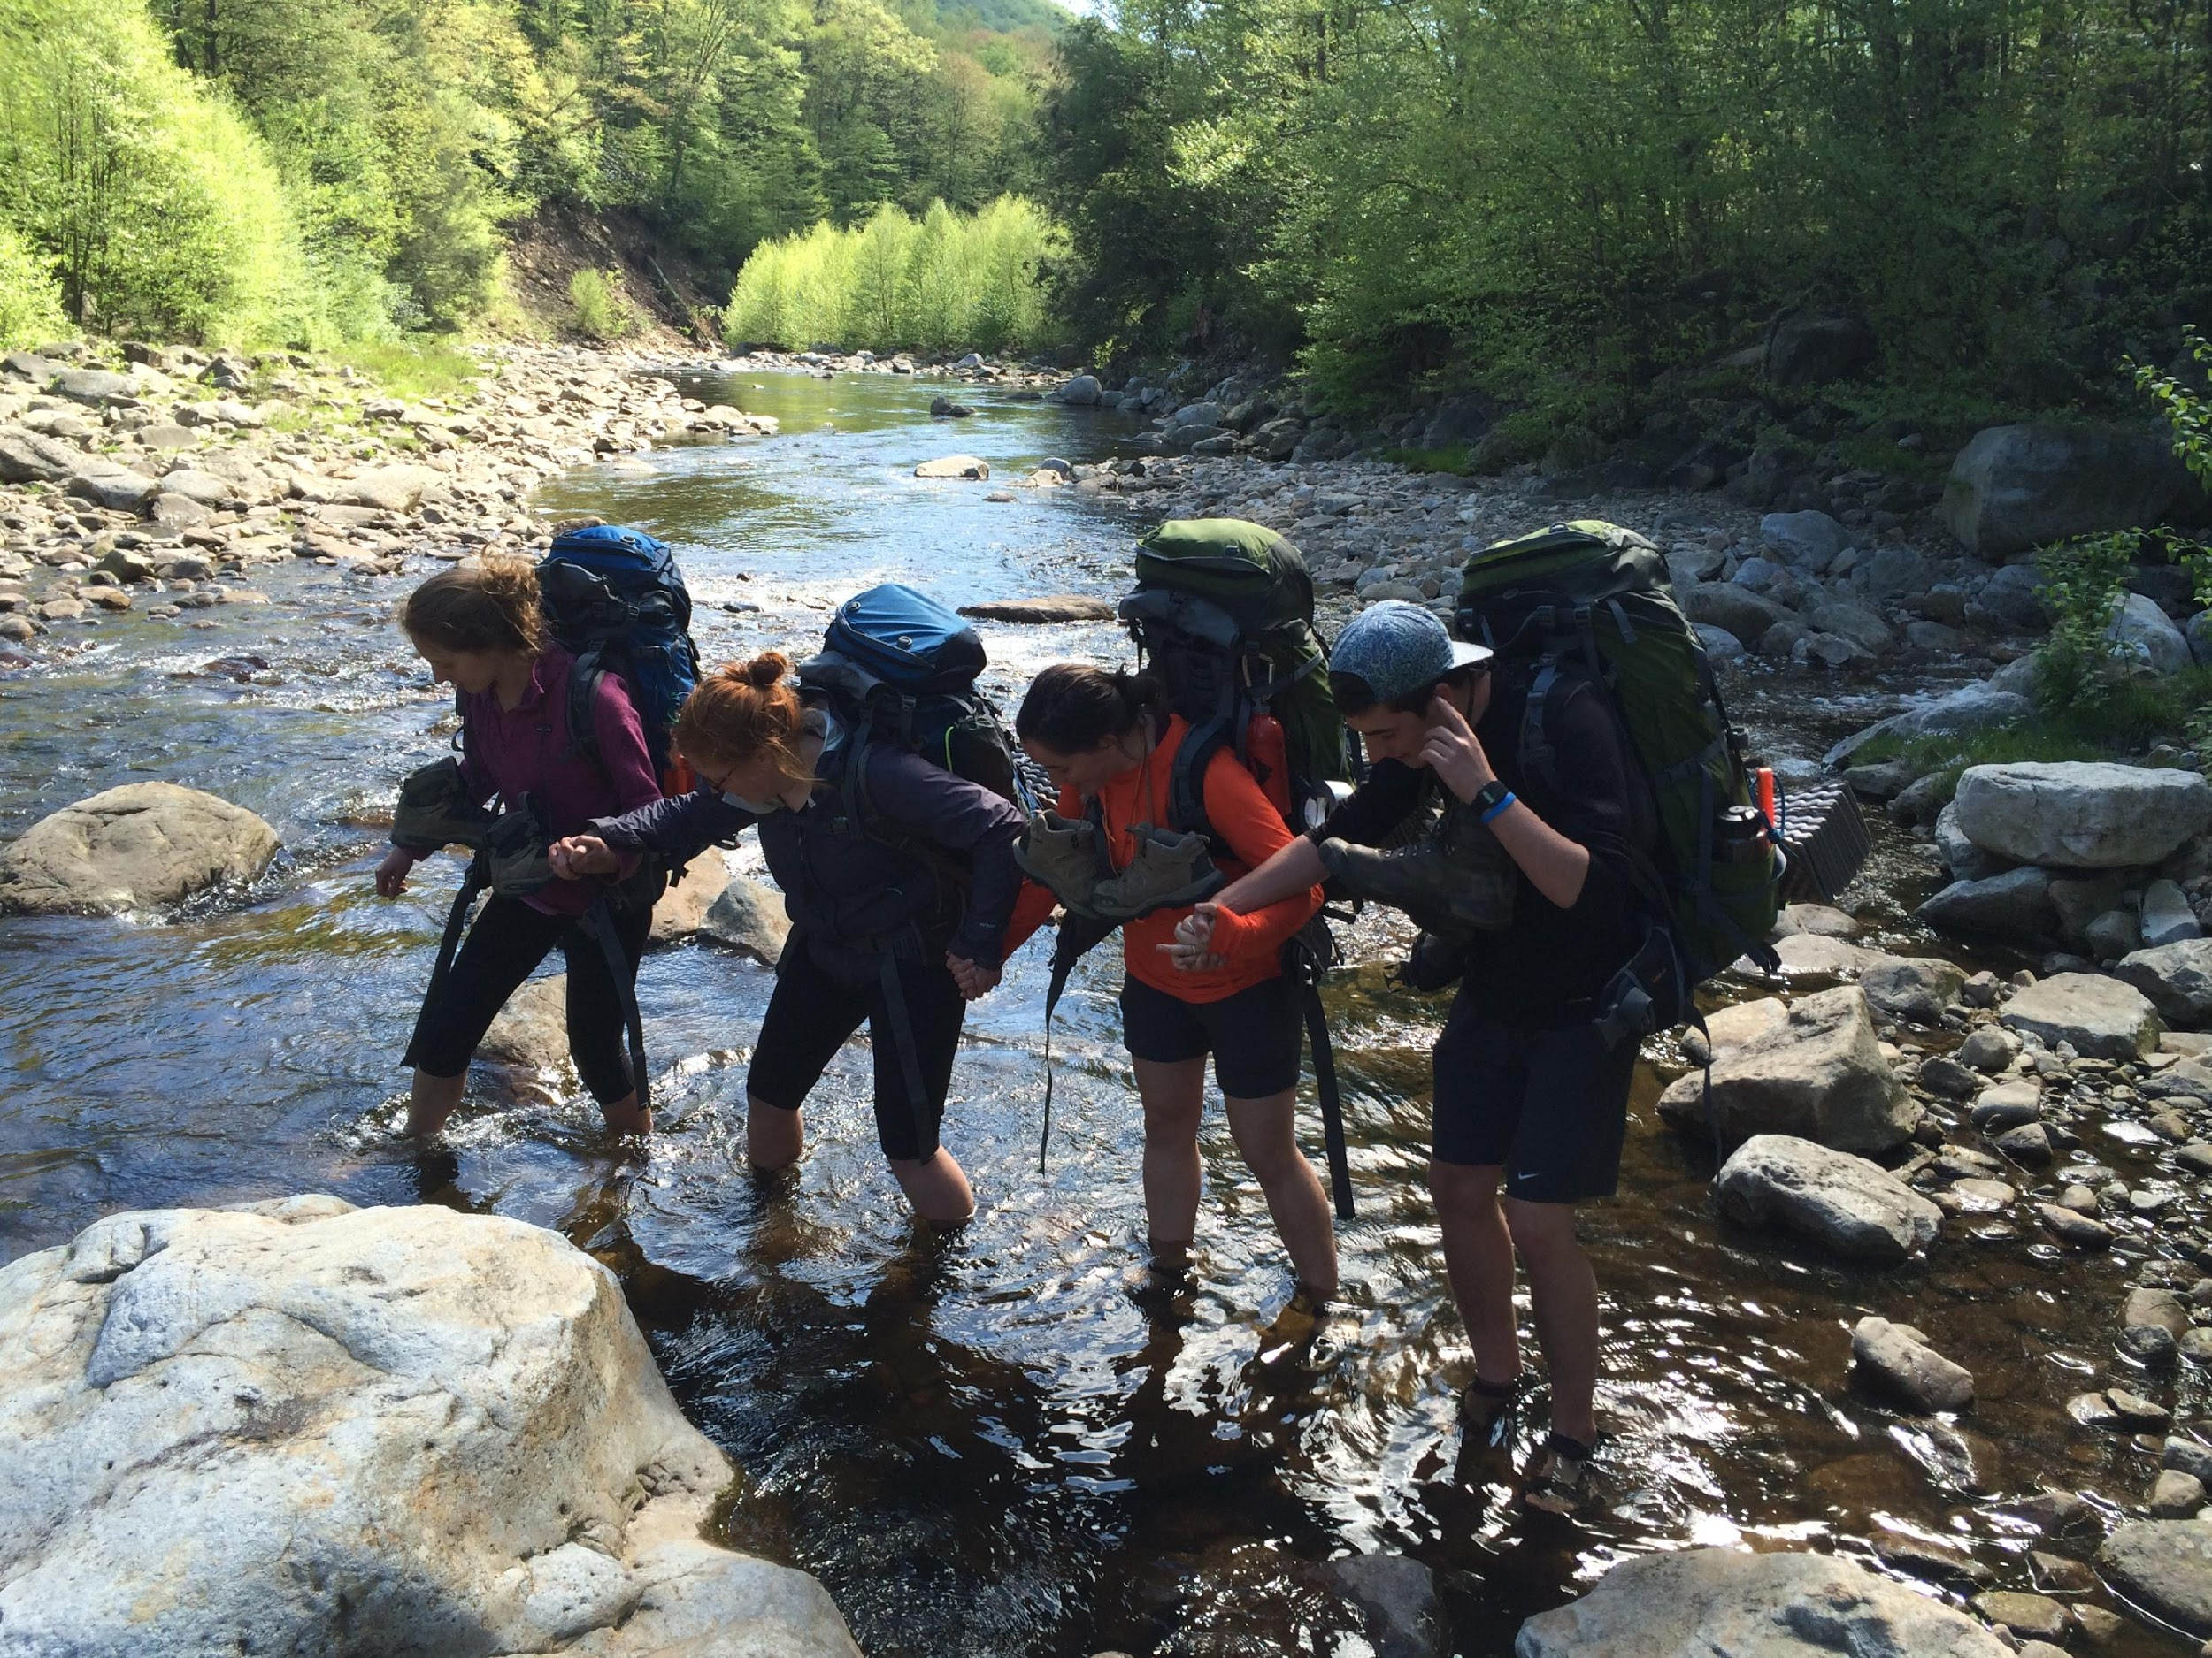
OE Trips
40 Plus trips over the course of the year on the calendar each semester
Hiking, backpacking & climbing are our main programming areas.
Some paddling, caving, and skiing.
More inclusive for beginners such as pumpkin picking
2018-2019
40+ trips offered, 26 run with 184 student
participants (avg 7 per trip)
1,856 field hours
Fall 2018
13 trips with 109 student participants
872 field hours

Slide 5
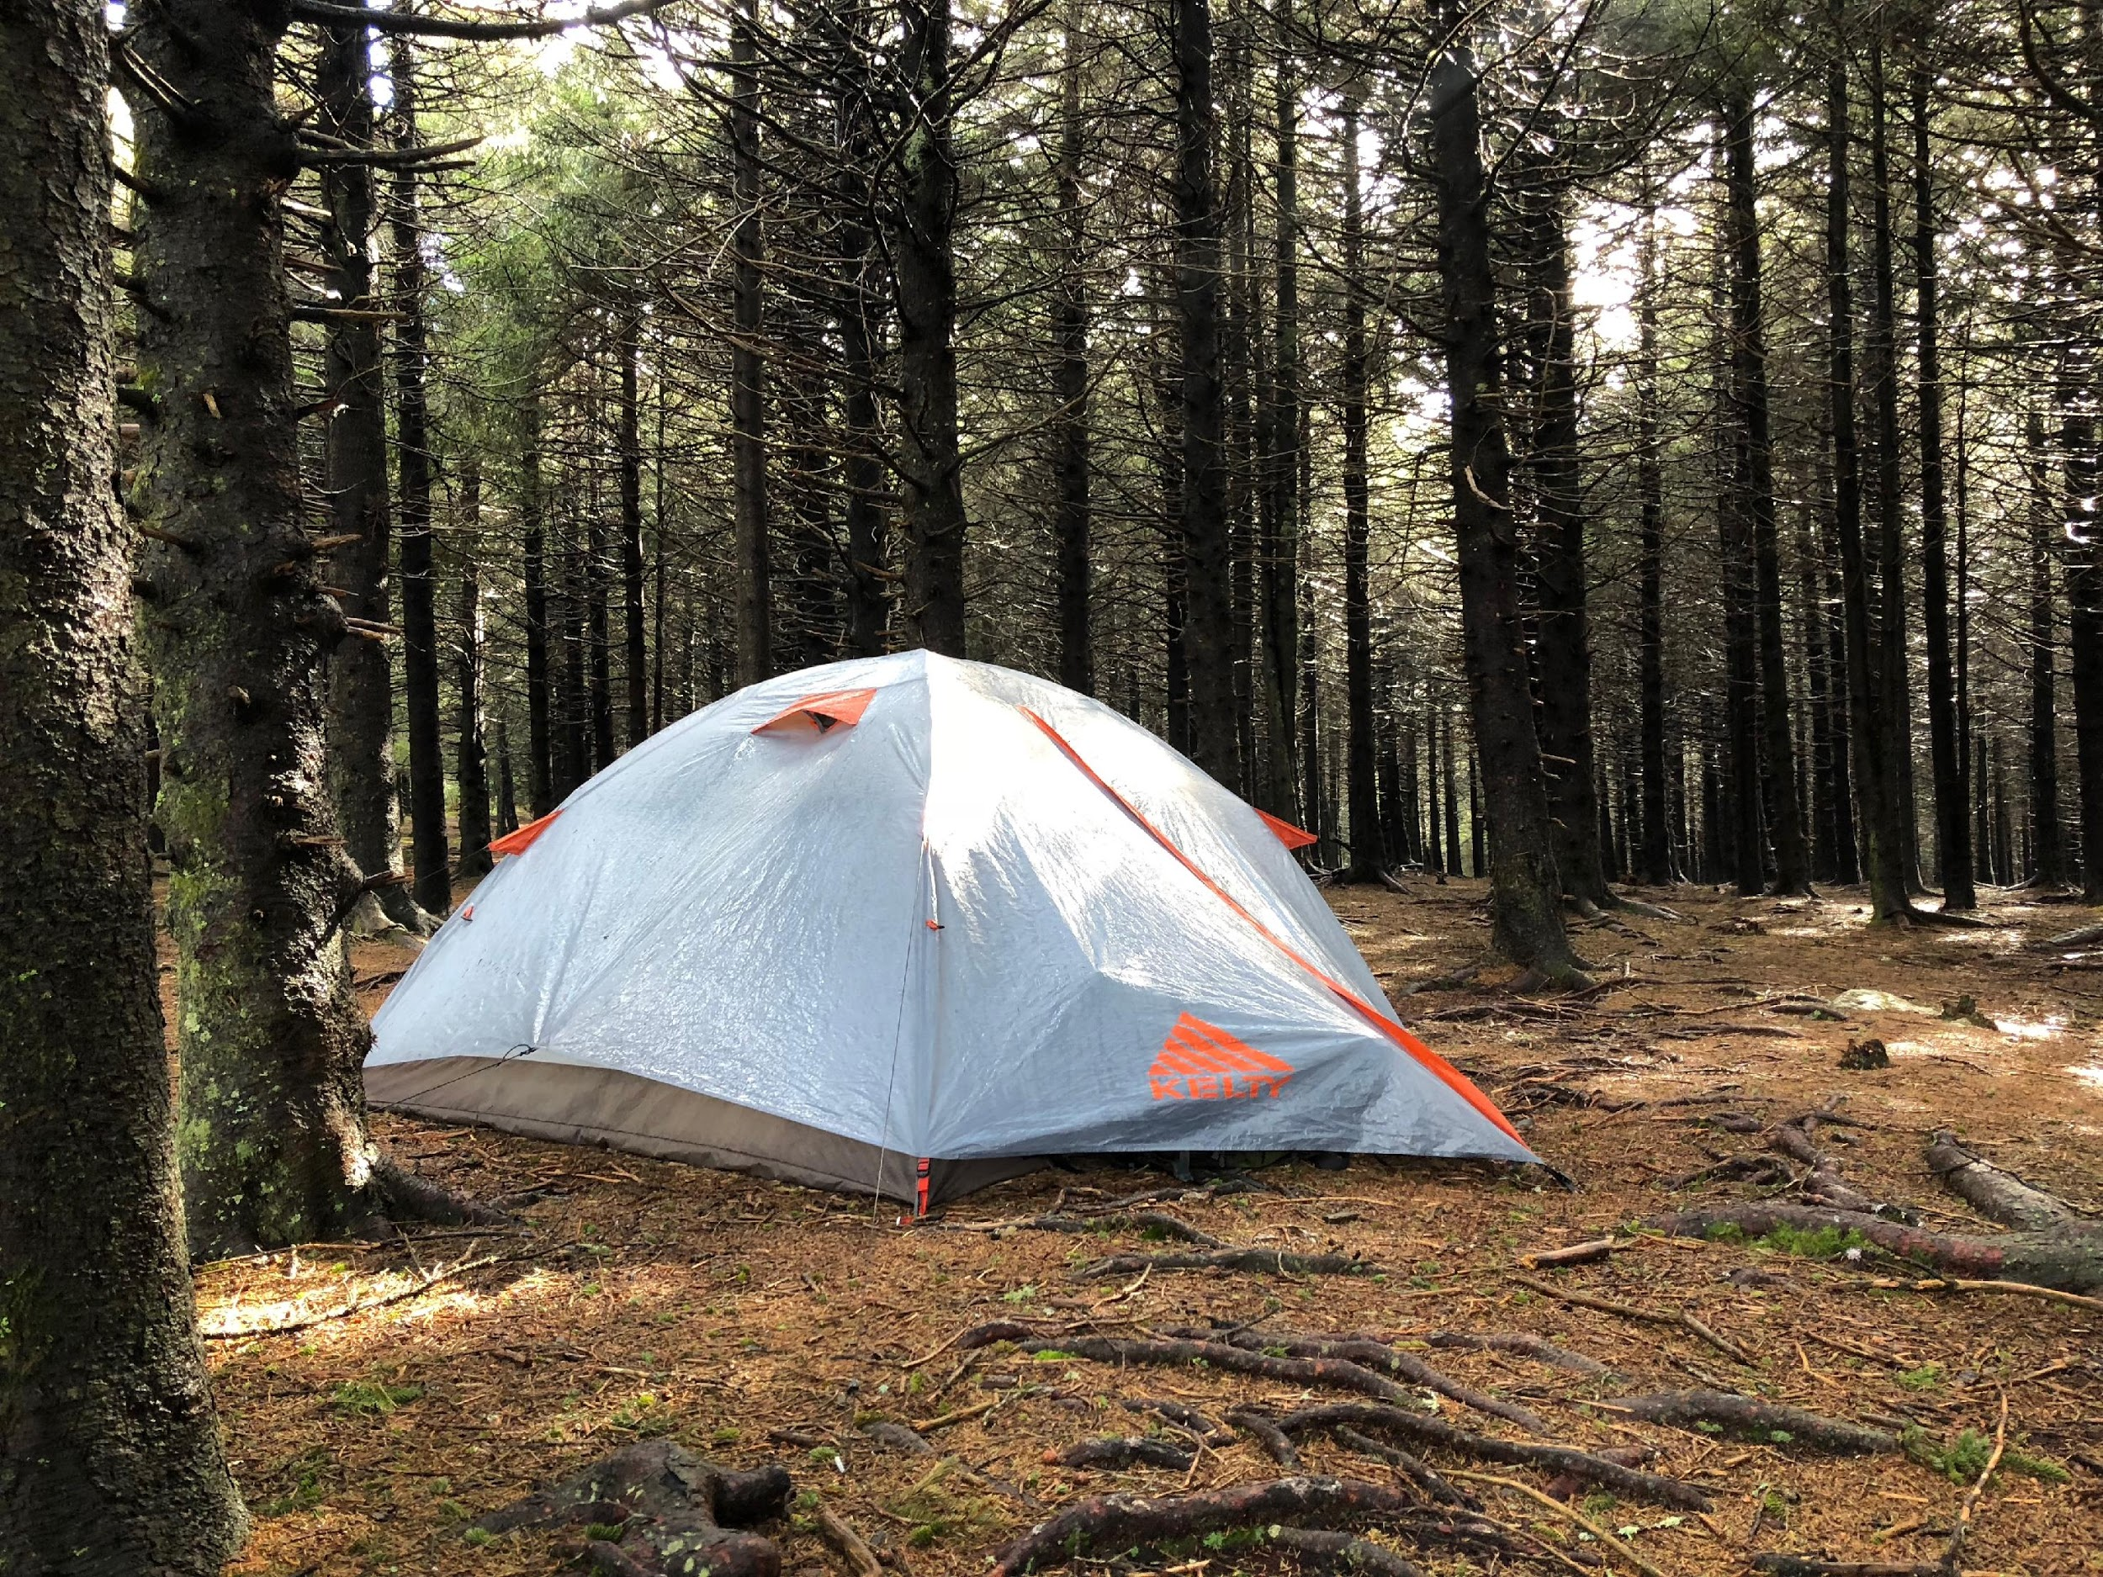
Equipment
OE trips need specific equipment
This year’s request - $2,250
Stoves
Sleeping bags
Backpacks
Climbing shoes
Water filtration system

Slide 6
OE Student Lead Trainings Trainings
Trips need to be safe.
Training is a priority – need to give OE guides the skills they need while in the field running trips.
New Staff (GOAT) training course – Outdoor Education
Fall semester
On and Off campus
1,300 field training hours
1,000+ miles traveled

Slide 7
Externally Lead Training
Wilderness First Responder – Wilderness Medical Associates
Required of all OE Guides
80 hour course
Wilderness Protocols
Top Rope Certification – Earth Treks
Must have 2 certified guides per climbing trip
Required by National Park Service
Anchor set-up, belay & rappel management, rescue skills

Slide 8
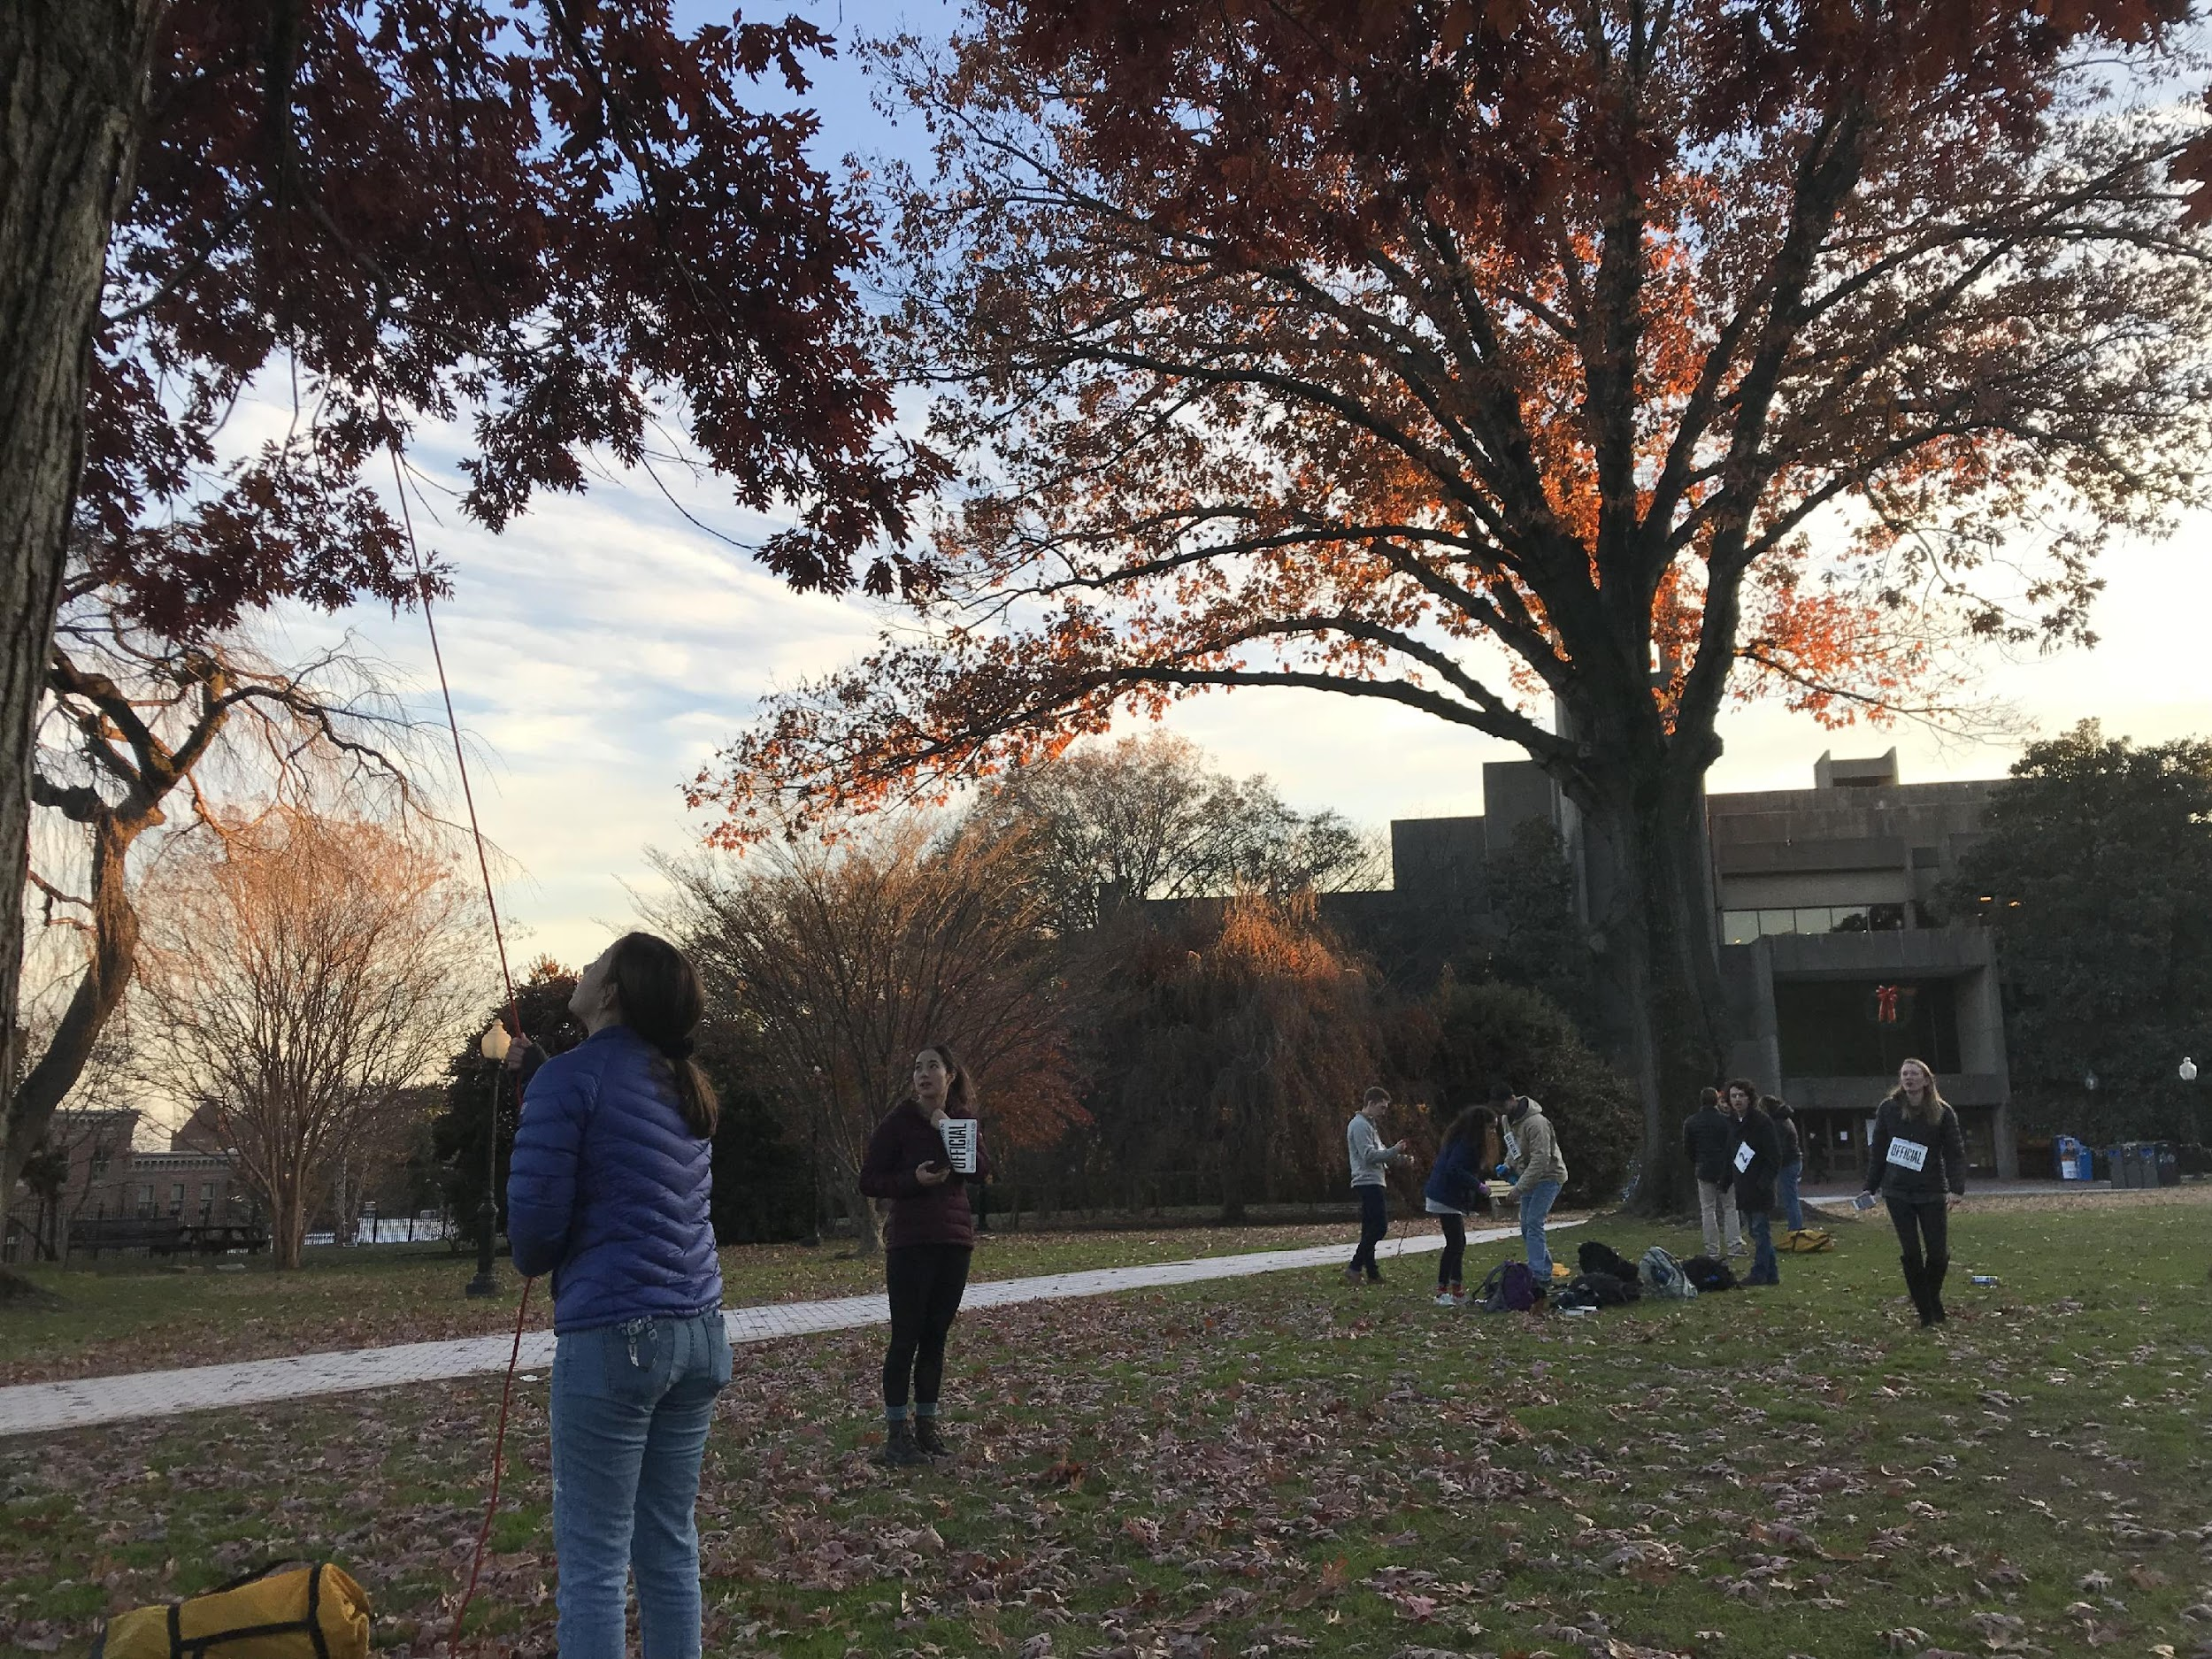
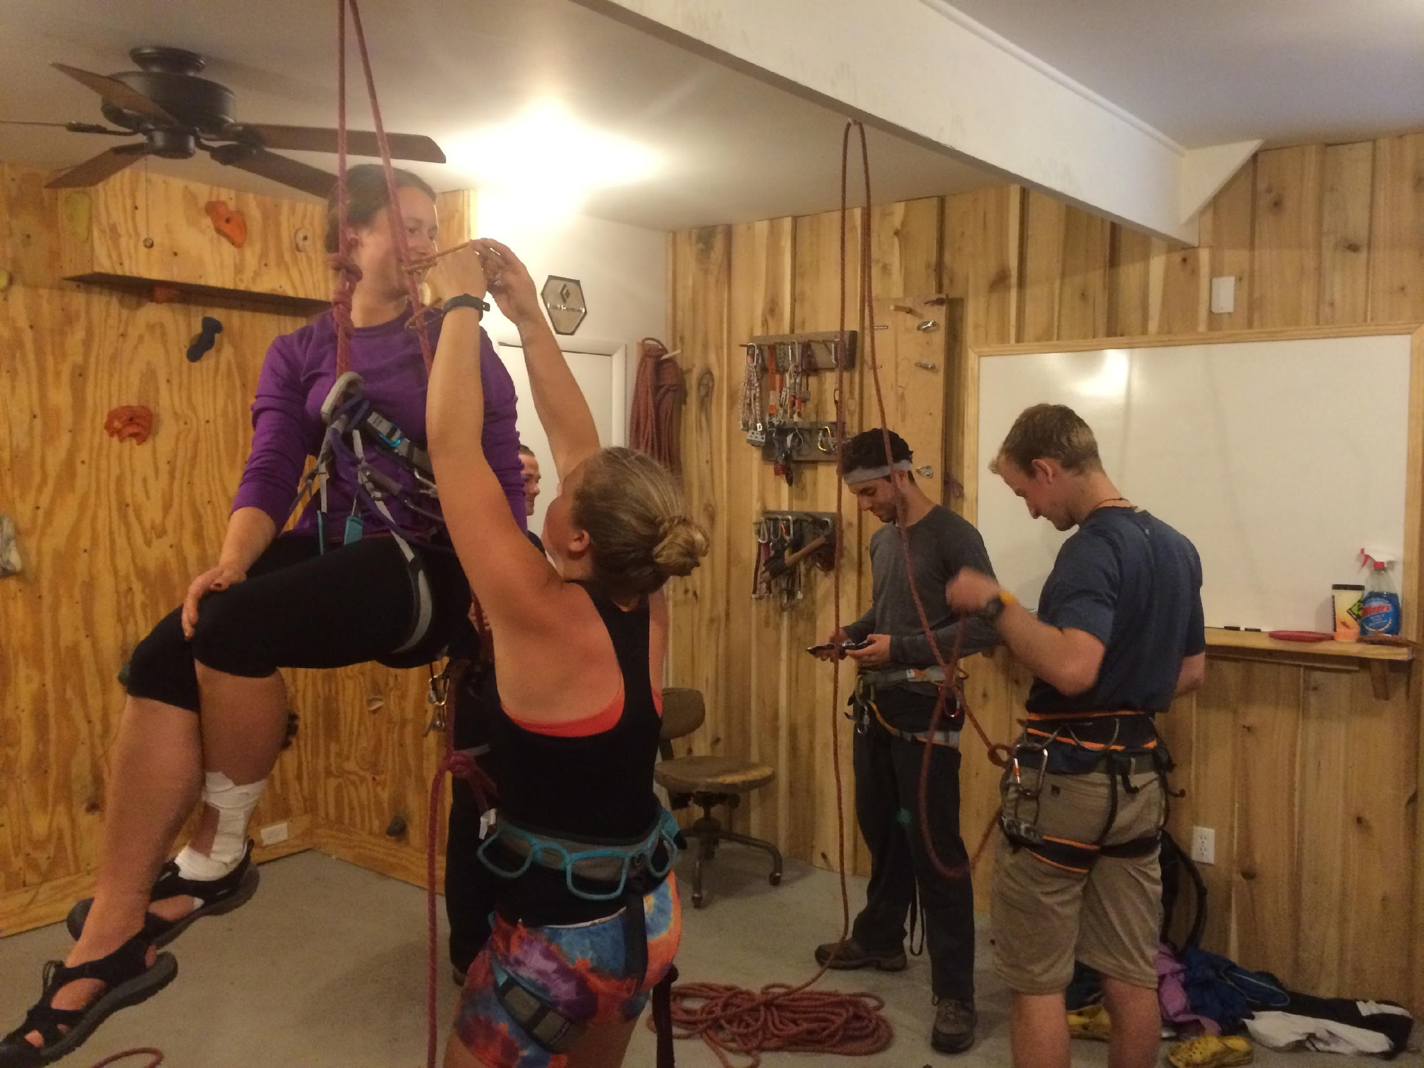
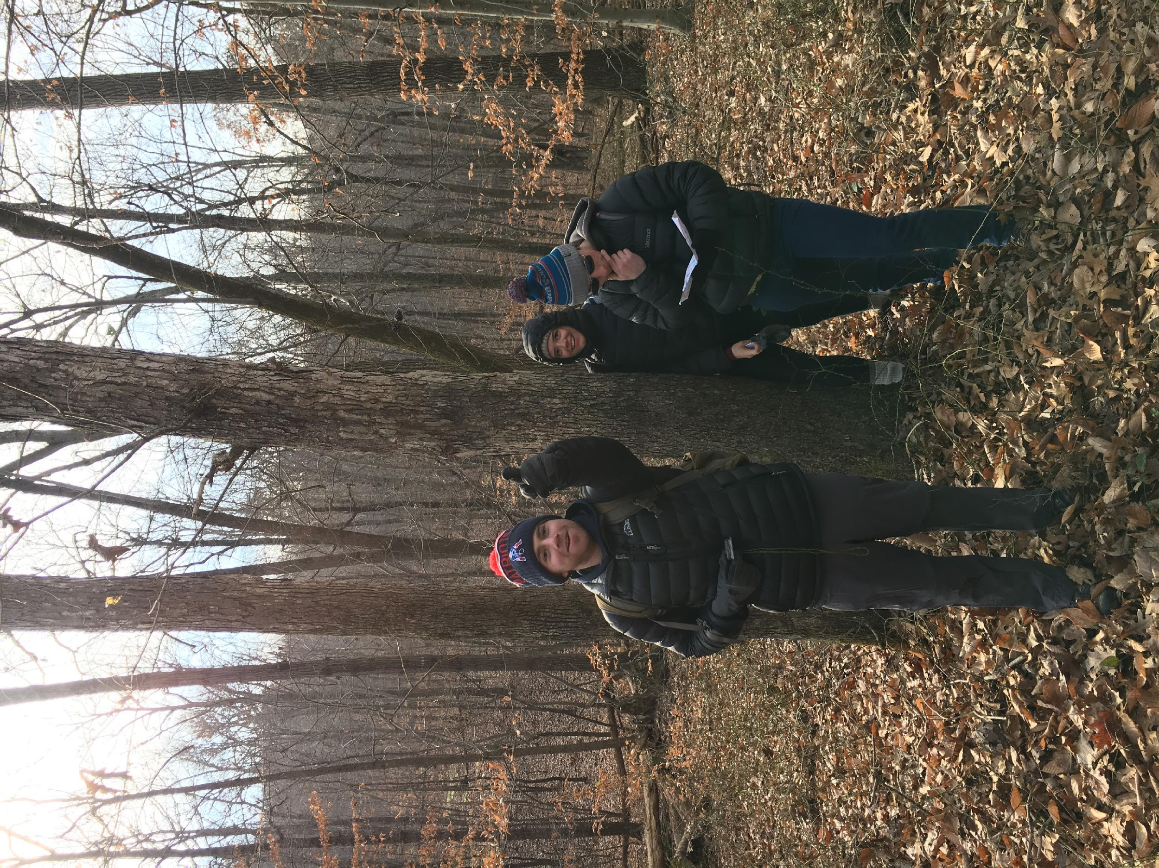
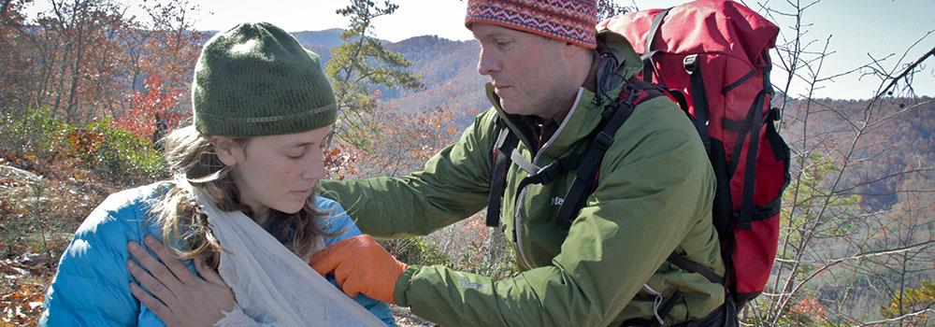
OE Training
OE guides pay approximately 20% of both their WFR and Top Rope Certification.
This year’s request - $13,390

Slide 9
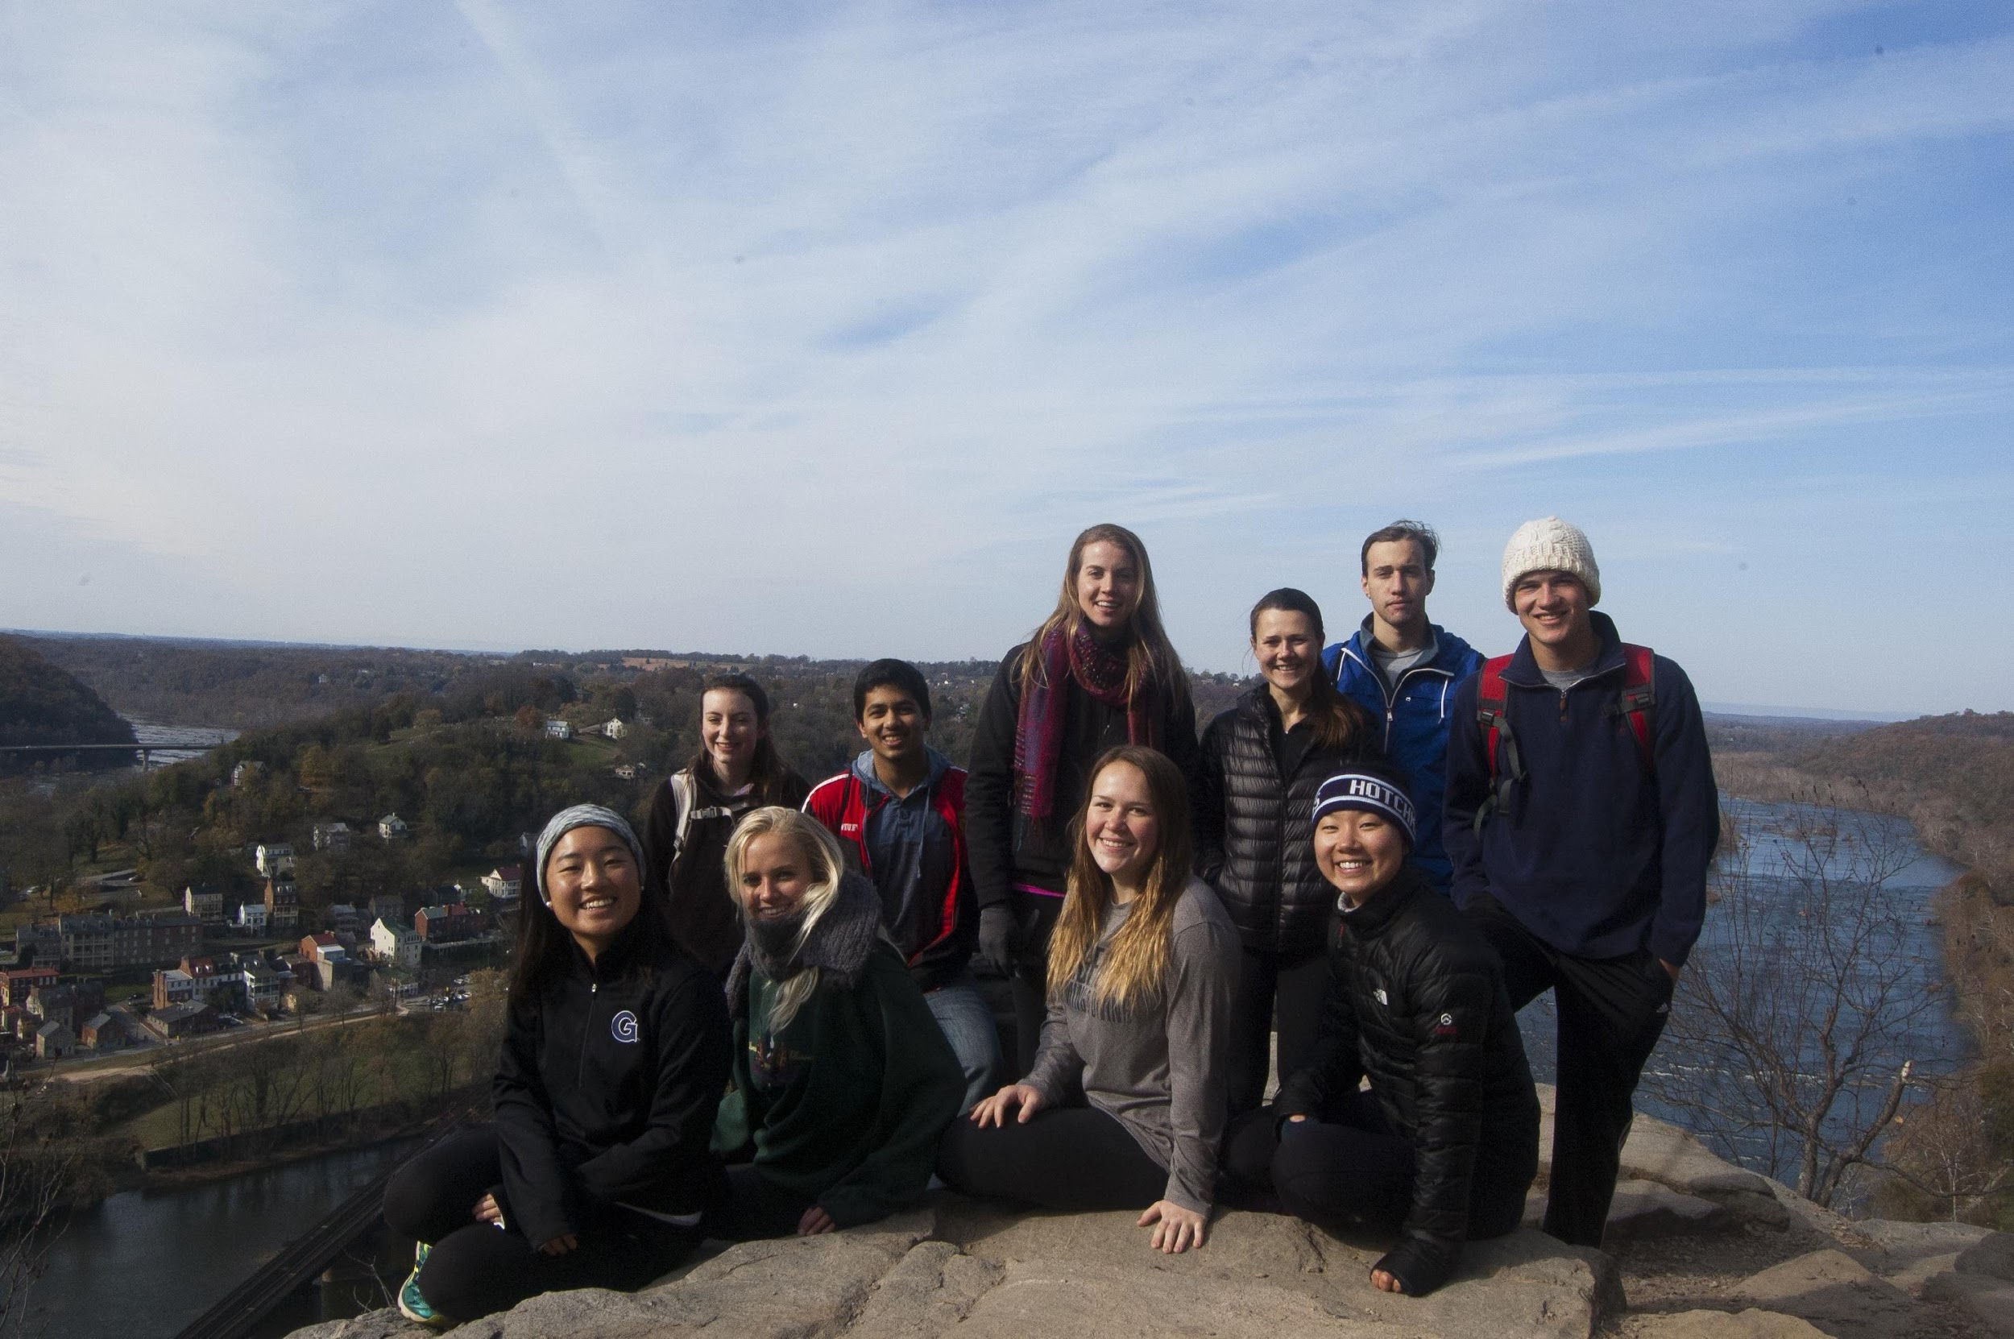
OE Budgeting
OE Trips – offered at cost
Access to students
OE subsidizes trips when needed.
GOPOP has traditionally been source of the OE operating budget.
$6,000 transportation costs
$3,500 in student aid
GOPOP 2018 – essentially made $1,500 which we are using to subsidize trips throughout the semester and next years GOPOP

Slide 10
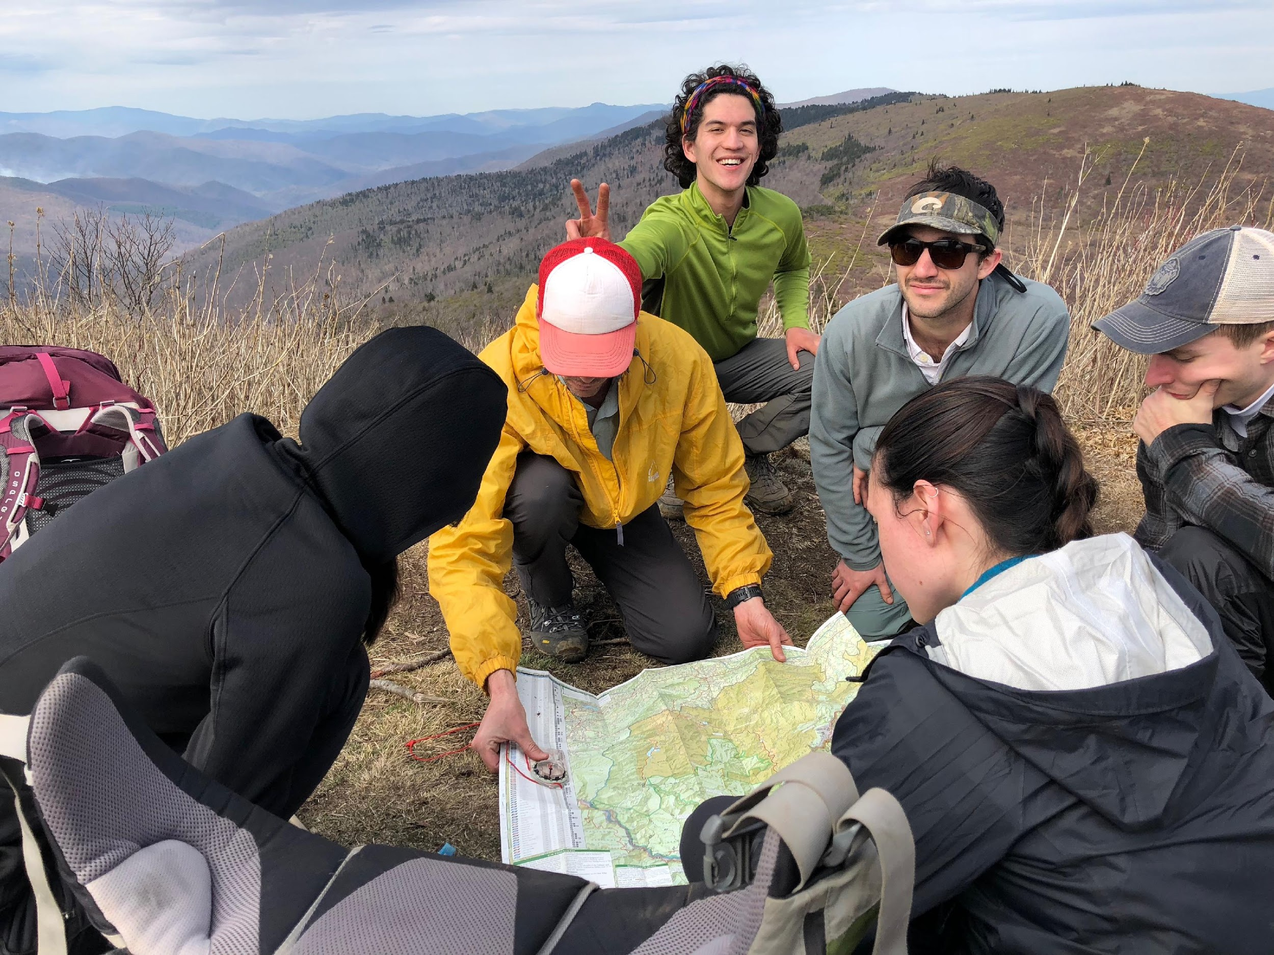
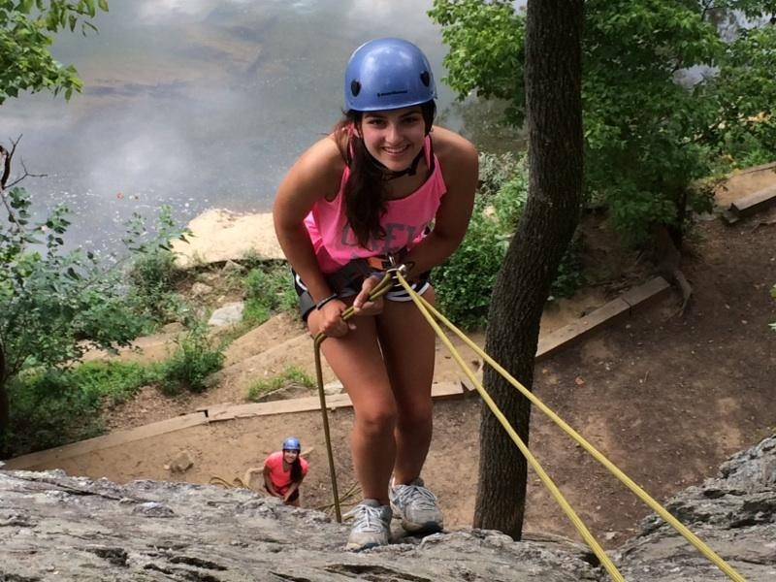
Need for GUSA Support
GUSA Funding allows OE to continue to run high quality programs for the students of Georgetown University.
Trips can be run at low cost = student access. ($5-$10 range and include food)
OE Guides are well trained, run trips within their skill level.
Equipment and Training are expensive.
Without GUSA support:
Equipment and training costs passed onto students participating on trips.
Less student access
Guides
# of trips

Slide 11
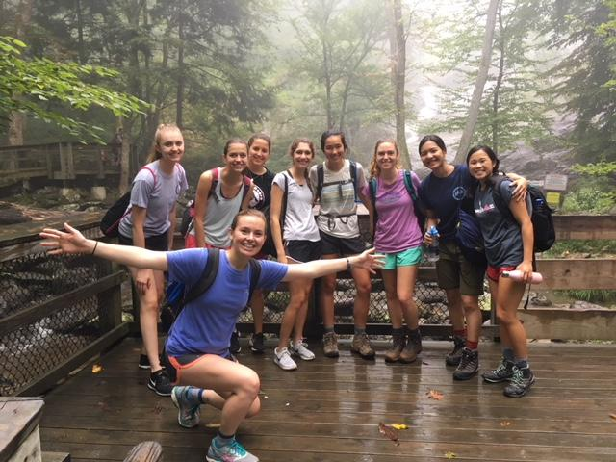
Questions?

